Slide 1
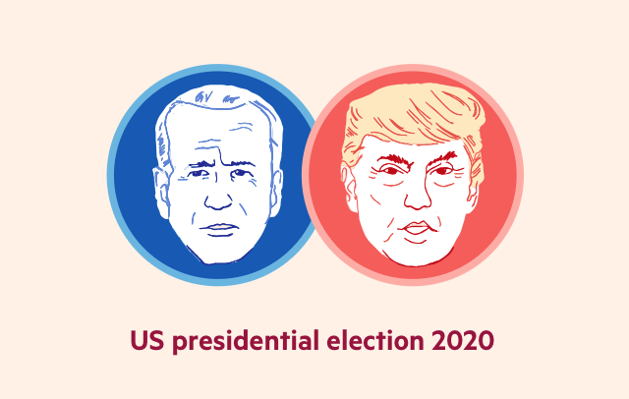
Tweets predict presidential outcomes better than polls??
Biden vs Trump: who is leading the 2020 US election.
Jiahe Zhang, Shaoqian Chen, Tianxiao Yu, Zhounan(Madison) Wang

Slide 2
Bottom Line Up Front
Project Background
The US Presidential election is the hottest topic in 2020 besides of the COVID19.
Twitter is one of the most commonly used and successful social medias of our time
Can social media predict better outcome result than the traditional polls?
Problem statement
Text mining based on Timeserial and sentimental analysis.
5000 tweets per day over the last three weeks (From Oct.12-Nov.3)
Notes:
In this project, we want to use data collected on Twitter to predict the outcome of the most trending topic at this time - the U.S presidential election scheduled for November 3rd, 2020.
Given sets of positive, neutral and negative replies collected under presidential candidates’ most recent tweets, this project analyzes the sentiment of the public and makes a prediction about the outcome of the latest U.S. presidential election focusing on two candidates

Slide 3
Agenda & Timeline
Guideline Setup
Data Scraping
Text analysis
Data Visualization
Data Visualization
Week of Oct.12
Week of Oct.19
Week of Oct.26
Week of Nov..9
Week of Oct.16

Slide 4

Twitter API
Now: most recent 5000 replies/retweets under each presidential candidate’s tweets every day since Oct.12th
Future: 5000 replies/retweets from different time period
Notes:
The raw data we are using are retweets/replies under Trump and Biden’s tweet. As for now, we have obtained the m.recent 5000 replies for each of them everyday since Oct.12th. And in the future, we are planning to get 5000 replies/retweets from different time period (e.g. 5000 from 10 to 11 and another 5000 from 11-12) every day.

Slide 5
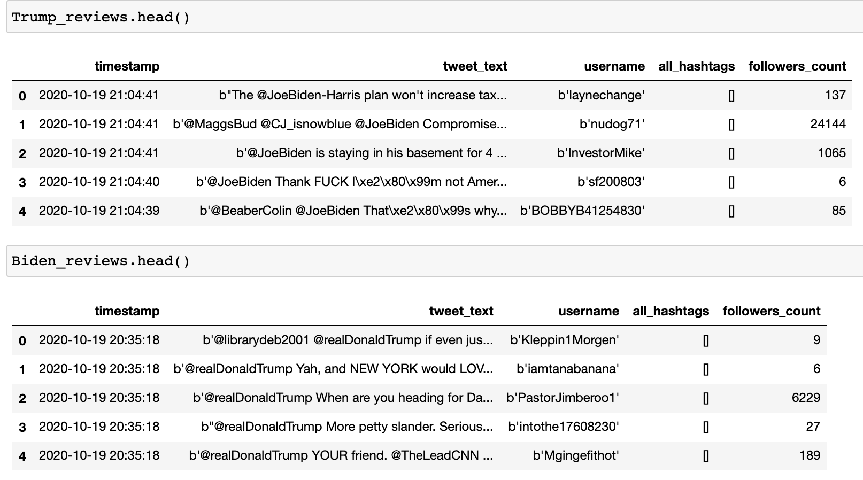
Notes:
The raw data we are using are retweets/replies under Trump and Biden’s tweet. As for now, we have obtained the m.recent 5000 replies for each of the presidential candidate everyday since Oct.12th through twitter API. And in the future, we are planning to get 5000 replies/retweets from different time period (e.g. 5000 from 10 to 11 and another 5000 from 11-12) every day.
Here is the sample of out input data.

Slide 6
Sentiment analysis
Reply under Trump‘s
"b'@MaggsBud @CJ_isnowblue @JoeBiden Compromised??? Also: Corrupt, Compliant and Owned by Russia!!!'"
Sentiment(polarity=-0.9765625, subjectivity=1.0)
Reply under Biden‘s
b'@realDonaldTrump Yah, and NEW YORK would LOVE to collect the taxes you owe them!
Sentiment(polarity=0.3806818181818182, subjectivity=0.5272727272727272)

Slide 7
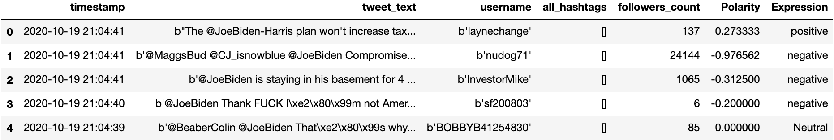
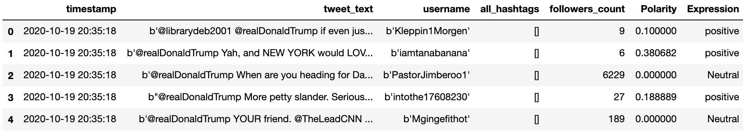
Trump
Biden

Slide 8
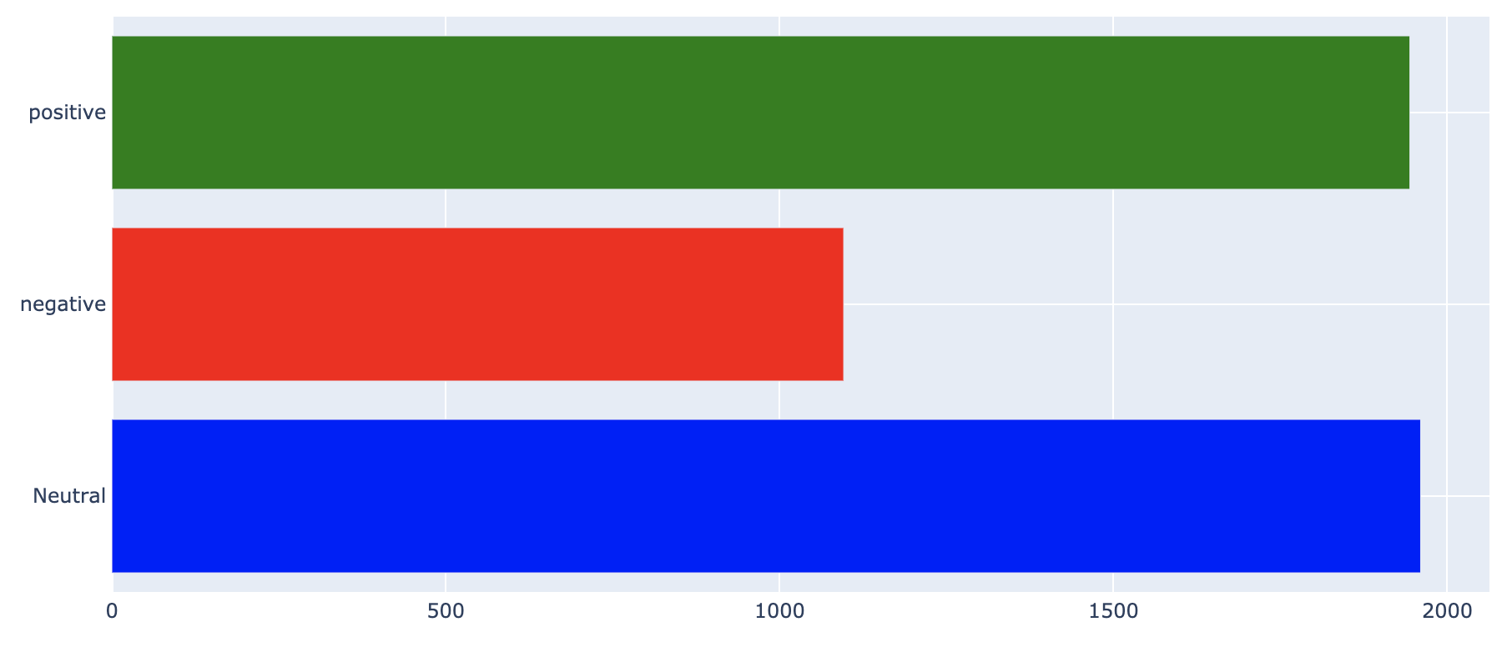
Trump

Slide 9
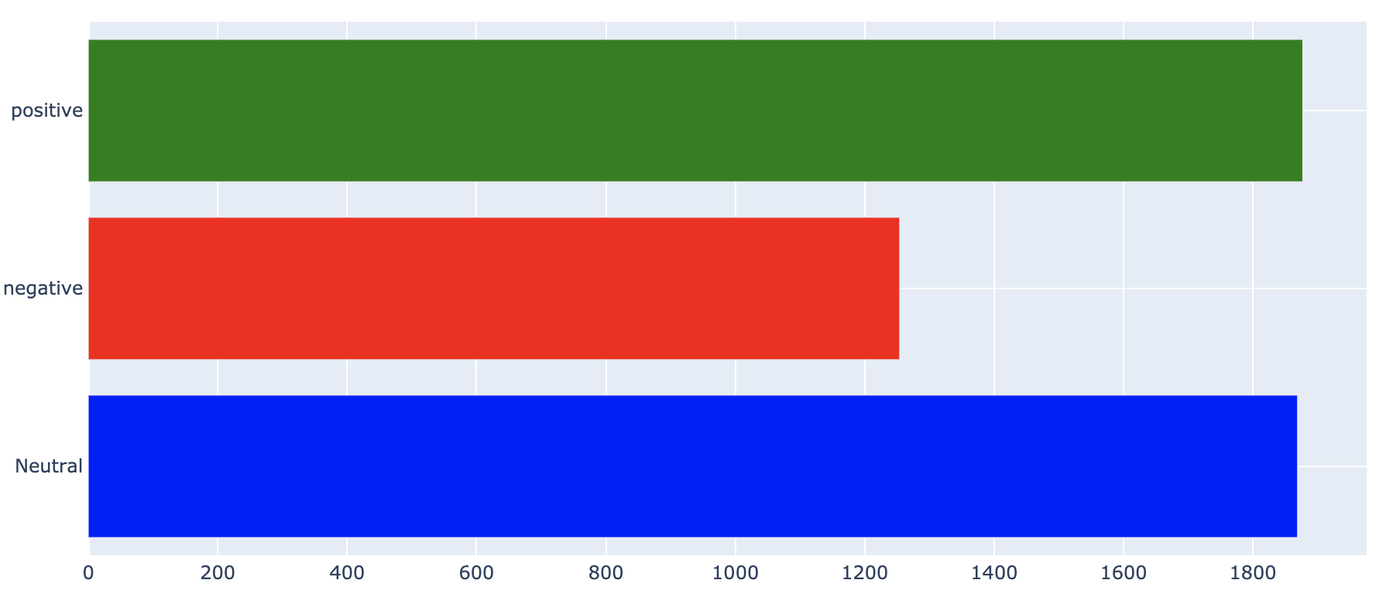
Biden

Slide 10
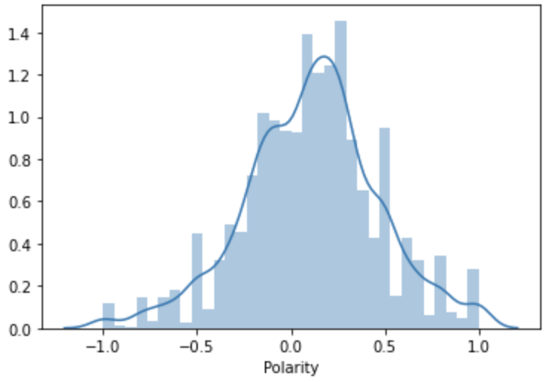
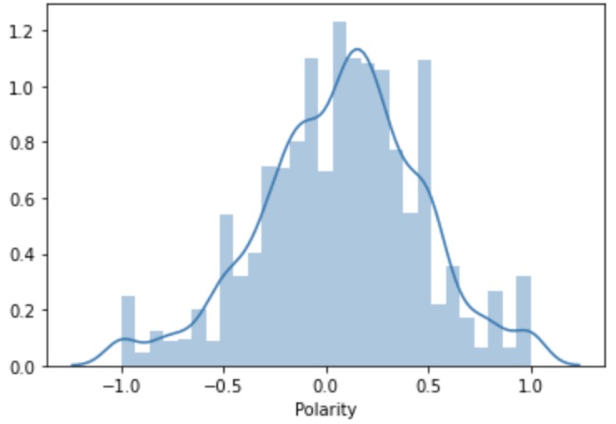
Visualization
Trump
negative_per is 36.1, and positive_per is 63.9.
Biden
negative_per is 39.6, and positive_per is 60.4.

Slide 11
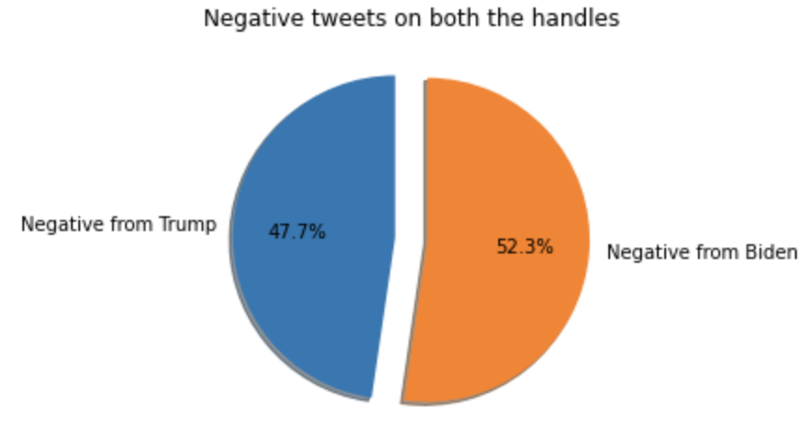
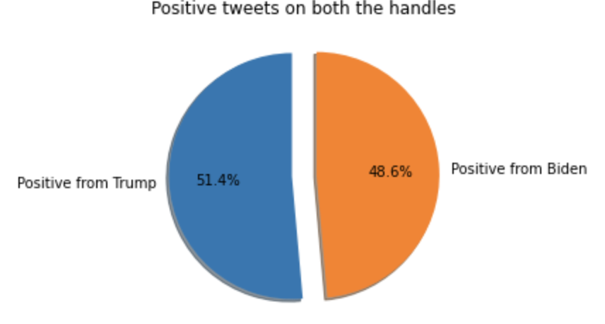

Slide 12
Evaluation Metrics
5000 tweets per day over the three weeks
First part result of polls (Oct.12-Oct.21)
First part(One and half week
Second part(One and half week
Second part result of polls (Oct.22-Nov..2)

